Slide 1
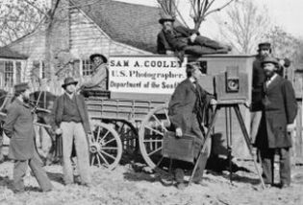
Civil War Photography
Please have your PRETEST on your desk!

Slide 2
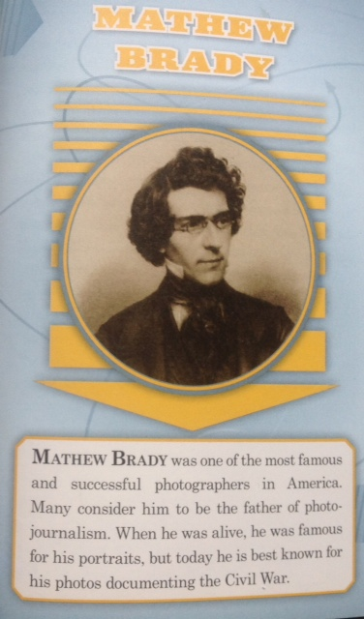

Slide 3
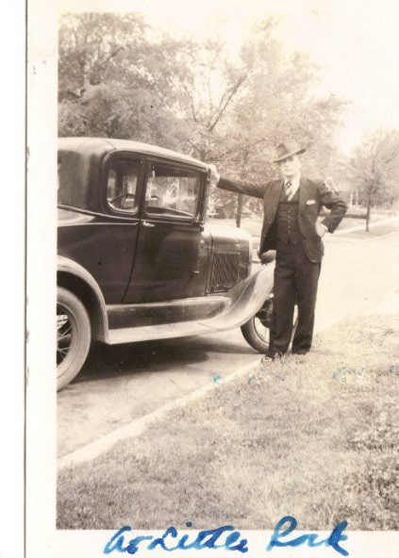
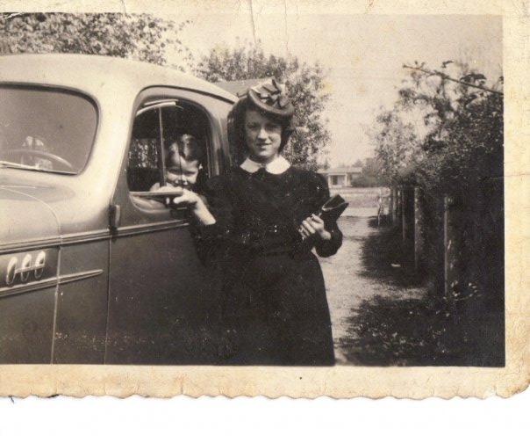
Old Pictures:
Have you ever looked at really old pictures of your parents or grandparents?
Old pictures can tell us things about the past.
  Give an example using my old family photos above
Today, we are going to look at old photographs from the Civil War and use them to look for clues about the past and to understand what it was like to live back then.

Slide 4
When we study an event in history and we use a piece of writing from that time, what would we call that type of document?
  A primary source
  A primary source is a document, speech, or other sort of evidence written, created or otherwise produced during the time being studied.
Is a photo considered to be a primary source?
  Yes!

Slide 5
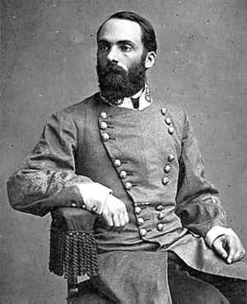
The Civil War
While photographs of earlier conflicts do exist, the American Civil War is considered the first major conflict to be extensively photographed.
For the first time in history, citizens on the home front could view the actual carnage* of far away battlefields. Civil War photographs stripped away much of the romance around warfare.
*death and destruction

Slide 6
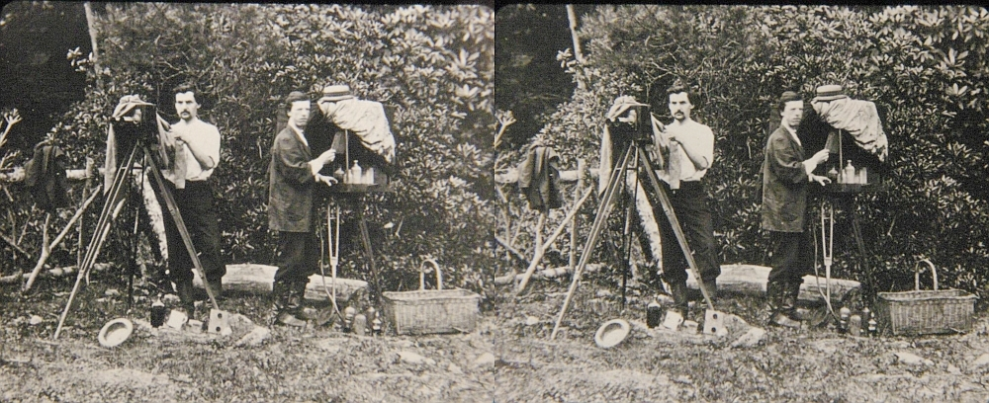
Today pictures are taken and stored digitally, but in 1861, the newest technology was wet-plate photography, a process in which an image is captured on chemically coated pieces of plate glass. This was a complicated process done exclusively by photographic professionals.

Slide 7

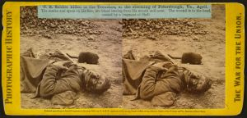
3D!
Red on left!
Did you know that an estimated 70% of all Civil War documentary photographs were shot as "stereoviews" - the 19th Century equivalent of 3-D?

Slide 8
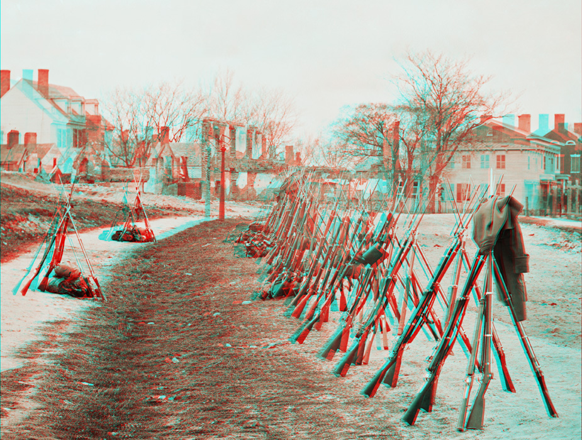
Photo #1
Photography as a Primary Source Interactive Worksheet.
Question 2.
Look at this first 3-D picture from the Civil War.
  a.
  b.
  c.
  d.
  e.
  f.
  g.
  h.

Slide 9
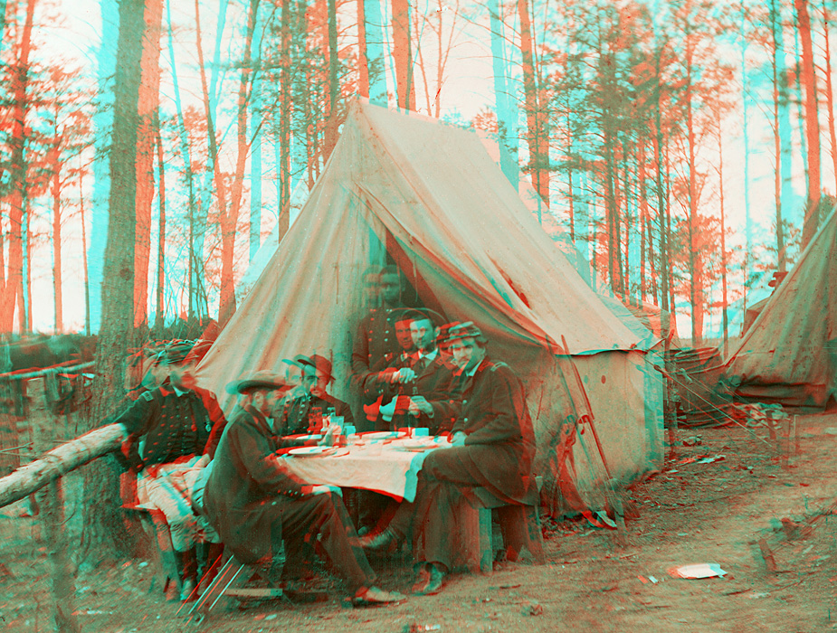
Photo #2
Question 3:
a.
b.
c.
d.
e.
f.

Slide 10
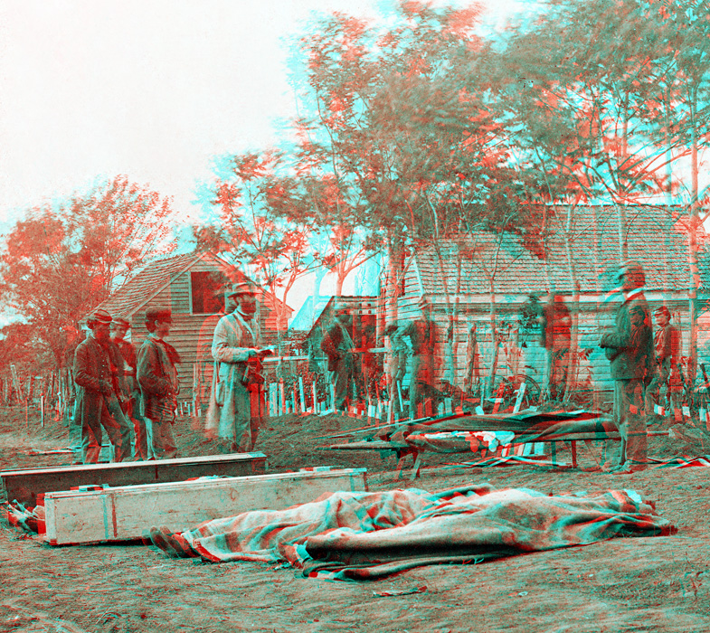
Photo #3
Question #4
a.
b.
c.
d.
e.

Slide 11
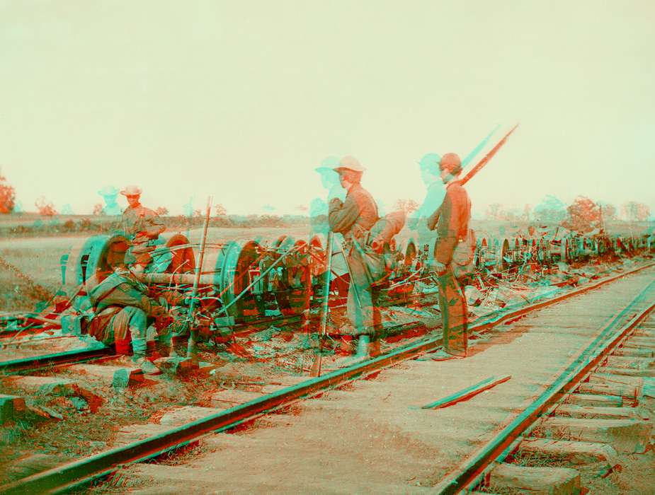
Photo #4
Question #5
a.
b.
c.
d.
e.
f.

Slide 12
3-D Gallery of Civil War Photos
Use my powerpoint to finish answering questions on handout.
Using this website: http://www.civil-war-150.com/3d-civil-war-photographs/ **you will need to scroll DOWN
Choose one or two images that interest you.
Copy the image(s) into a word document (OR wordpad) by RIGHT CLICKING ON THE IMAGE.
Explain the image(s) by answering:
  Where was it taken? Can you tell if it’s in the North or South?
  What is happening in the image? Describe what it must have been like to be present in the photo.
  What can the image tell us about the Civil War? What clues exist about the past?
  Why did you choose the image(s)?
  PRINT your document. (Problems printing? Email me lwilliams@nafcs.k12.in.us

Slide 13
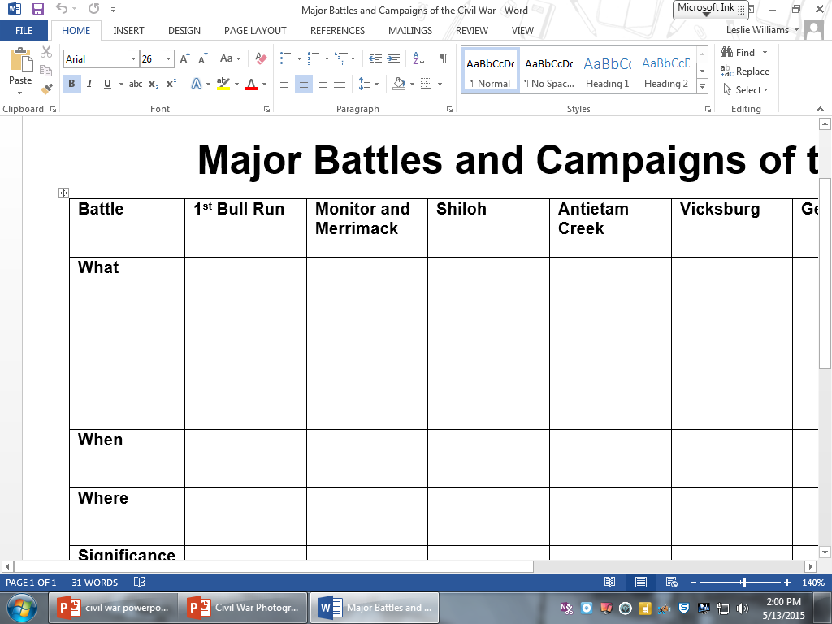
Major Battles & Campaigns of the Civil War
Use my webpage then ‘important websites’.
http://stmary11030.org/UserFiles/Servers/Server_51638/File/Major%20Battles%20and%20Campaigns%20of%20the%20Civil%20War.pdf
Then fill in your chart: What? When? Where? Significance?

Slide 14

Wednesday, May 18, 2016
Please make sure your name is on your 3D lab printout.
Turn it in to the podium now.
On your desk, please have:
  MAJOR BATTLES AND CAMPAIGNS OF THE CIVIL WAR chart
  Pen/pencil

Slide 15
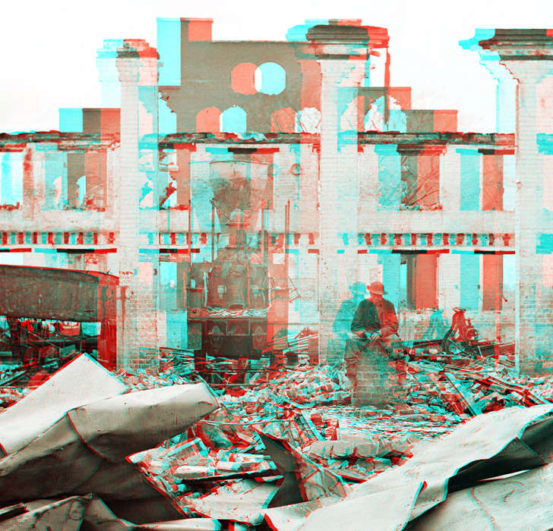
Assessment photo
Look at the picture.
What do your notice first about this picture?
Where do you think this picture was taken? How can you tell?
What do you think these are the remains of?
Why do you think the photographer chose to take a picture with a man in it?

Slide 16
http://www.civilwar.org/photos/3d-photography-special/
http://www.civilwar.org/photos/3d-photography-special/
https://www.civilwar.org/learn/galleries/civil-war-3-d

Slide 17
Live Binder Computer Lab
Go to our school webpage.
Select ‘livebinder’ website
The access code is hhms.
Follow directions on the screen.
Complete
  Web ranger questions
  Camp Life Questions
  Venn Diagram
http://mrswilliamshistoryclass.weebly.com/

Slide 18
Extra Credit: Scenario 10 points!
3-D movies are very common and profitable. You have been asked to come up with a 3-D movie based on the Civil War.
Choose an image from the galleries you’ve visited online as the setting for a movie.
Create a movie plan USING THE IMAGE YOU CHOSE with the following info:
  Copy your image onto a word document.
  Location – describe the setting for the movie in a sentence or two.
  Who – Create 3 characters to star in your movie
    Actors – which actors should play those characters?
  When – what is the date/year/season for your movie? Is it near the beginning, middle, or end of the war? How can you tell?
  Story – create a sample script (one paragraph) for your movie EX: What would the characters/actors say that shows how your image gives info about the Civil War.

Slide 19
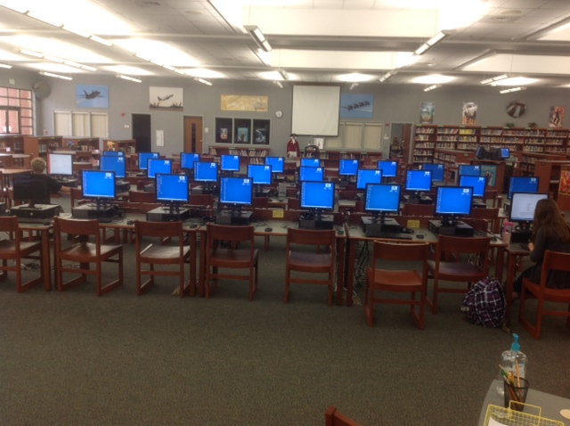
Computers 1-10
11-20
21-30
www.mrswilliamshistoryclass.weebly.com
Start at Important Websites and Select Civil War Powerpoint!

